Slide 1


ICS4ICS Exercise:
Pipeline
March 20, 2025

Slide 2
References

Slide 3
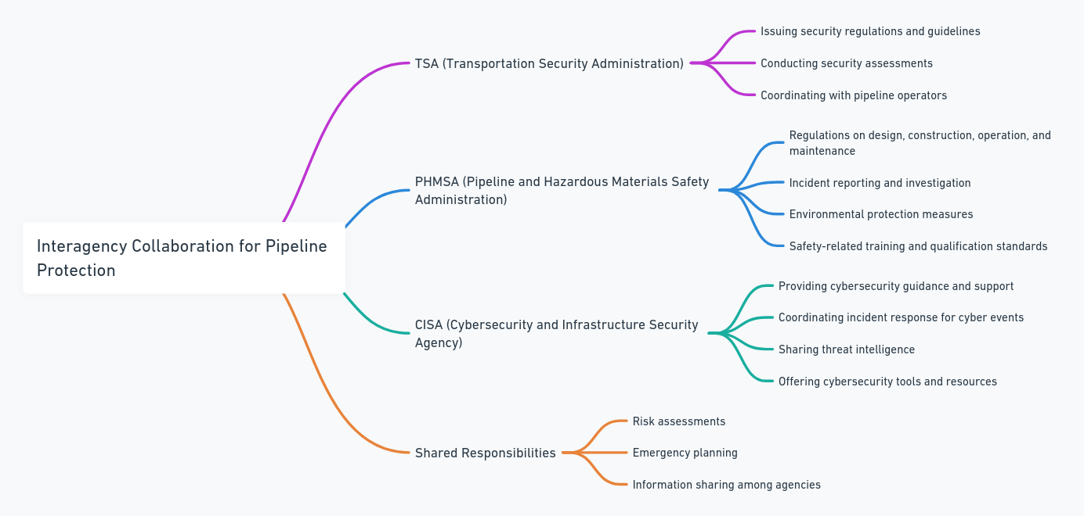
USA: Interagency Collaboration for Pipeline Protection
Notes:
Transportation Security Administration (TSA) has primary responsibility for pipeline security, Pipeline and Hazardous Materials Safety Administration (PHMSA) is responsible for pipeline safety regulations, and Cybersecurity and Infrastructure Security Agency (CISA) provides cybersecurity support. These agencies work together to protect pipeline infrastructure.

Slide 4
TSA's Role in Pipeline Security
The Transportation Security Administration (TSA), which is part of the Department of Homeland Security (DHS), plays a primary role in pipeline security. TSA's responsibilities in this area include issuing security regulations. They often involve:
Security plans: Pipeline operators must develop and implement security plans that outline measures to protect their assets. These plans are subject to TSA approval and audits.
Vulnerability assessments: Pipelines need to be assessed for potential security vulnerabilities, and mitigation strategies must be implemented.
Cybersecurity: Increasingly, TSA regulations address cybersecurity risks to pipeline control systems and data. Background checks: TSA mandates background checks for personnel with access to critical pipeline infrastructure.
Reporting requirements: Operators are required to report security incidents and vulnerabilities to TSA.
It's crucial to understand that specific regulations TSA implements are complex and evolve over time. To find precise current regulations, refer to the Code of Federal Regulations (CFR).
Notes:
For documents detailing specific requirements for security plans, cybersecurity measures, and other aspects of pipeline security, visit:
TSA website: https://www.tsa.gov/for-industry/resources#ui-id-9
GovInfo: https://www.govinfo.gov
Federal Register: https://www.federalregister.gov/documents/search
These resources provide most up-to-date information on pipeline security regulations and guidelines.

Slide 5
TSA Authority
Recent Security Directives for Pipeline Cybersecurity
Transportation Security Administration (TSA) has authority to issue security directives, notices, standards, and guidance related to pipeline security. In 2021, TSA issued multiple security directives in response to cybersecurity threats, notably after Colonial Pipeline ransomware attack. For example, Security Directive Pipeline-2021-01D requires pipeline operators to:
Enhance cybersecurity measures
Report cybersecurity incidents promptly
Designate cybersecurity coordinators
Subsequent directives further strengthened requirements for critical pipeline systems. These directives demonstrate TSA's role in adapting security measures to address emerging threats in the pipeline sector. Pipeline operators must comply with these directives to maintain secure operations. For most current information on TSA pipeline security requirements, refer to TSA's official website or Federal Register.

Slide 6
USA Comprehensive List of Authorities for the Pipelines Industry Overseen by the TSA – Page 1 of 5
The Transportation Security Administration (TSA) holds several authorities that empower it to oversee the security of the pipelines industry in the United States. These authorities stem from federal statutes, executive orders, regulations, and national policy documents. Below is a comprehensive list of these authorities:
Aviation and Transportation Security Act (ATSA) of 2001 (Public Law 107-71)
  Description: Established the TSA and granted it broad authority over all modes of transportation security, including pipelines.
  Key Provisions: Empowers TSA to develop policies, strategies, and plans for securing transportation modes.
49 U.S.C. § 114
  Description: Codifies the TSA's authority and responsibilities.
  Key Provisions: Outlines TSA's role in securing transportation, including the authority to issue regulations and directives.
Implementing Recommendations of the 9/11 Commission Act of 2007 (Public Law 110-53)
  Description: Expanded TSA's authorities, particularly in surface transportation security.
  Key Provisions:
    Section 1557: Mandates TSA to develop and implement a pipeline security program.
    Section 1558: Requires TSA to conduct security assessments and develop guidelines for pipeline operators.

Slide 7
USA Comprehensive List of Authorities for the Pipelines Industry Overseen by the TSA – Page 2 of 5
Security Directives Issued by TSA
  Description: Binding orders requiring pipeline operators to implement specific security measures.
  Key Directives:
    Security Directive Pipeline-2021-01 (May 2021): Requires reporting of cybersecurity incidents, designation of a cybersecurity coordinator, and vulnerability assessments.
    Security Directive Pipeline-2021-02 (July 2021): Mandates implementation of specific cybersecurity measures, development of contingency plans, and architecture design reviews.
49 Code of Federal Regulations (CFR) Parts Relevant to Pipeline Security
  Description: Federal regulations outlining TSA's security requirements.
  Key Parts:
  49 CFR Part 1570: General rules for all transportation modes under TSA's authority.
  49 CFR Part 1580: Specific security regulations for freight Pipeline transportation, which can overlap with pipeline security in certain contexts.
Pipeline Security Guidelines
  Description: Non-binding guidelines issued by TSA to assist pipeline operators in enhancing security.
  Key Features: Provide best practices for physical security, cybersecurity, and personnel security.

Slide 8
USA Comprehensive List of Authorities for the Pipelines Industry Overseen by the TSA – Page 3 of 5
Homeland Security Act of 2002 (Public Law 107-296)
  Description: Established the Department of Homeland Security (DHS), under which TSA operates.
  Key Provisions: Grants DHS and its agencies authority to protect critical infrastructure, including pipelines.
Executive Orders Related to Critical Infrastructure Security
  Executive Order 13636 (2013): Improving Critical Infrastructure Cybersecurity.
  Executive Order 13800 (2017): Strengthening the Cybersecurity of Federal Networks and Critical Infrastructure.
  Executive Order 13920 (2020): Securing the United States Bulk-Power System.
Presidential Policy Directive 21 (PPD-21): Critical Infrastructure Security and Resilience (2013)
  Description: Establishes national policy to strengthen and maintain secure, functioning, and resilient critical infrastructure.
  Key Provisions: Identifies pipelines as part of the nation's critical infrastructure and assigns roles to federal agencies, including TSA.
National Infrastructure Protection Plan (NIPP)
  Description: Provides the framework for integrating critical infrastructure security efforts.
  Key Features: Emphasizes collaboration between government and private sector to manage risks.

Slide 9
USA Comprehensive List of Authorities for the Pipelines Industry Overseen by the TSA – Page 4 of 5
Transportation Systems Sector-Specific Plan
  Description: A component of the NIPP focusing on transportation security.
  Key Provisions: Details strategies for securing transportation modes, including pipelines.
Energy Policy Act of 2005 (Public Law 109-58)
  Description: Addresses a range of energy-related issues, including security.
  Key Provisions: Includes measures for protecting energy infrastructure.
Cybersecurity Information Sharing Act of 2015 (CISA 2015)
  Description: Promotes the sharing of cybersecurity threat information between the private sector and federal agencies.
  Key Provisions: Enhances TSA's ability to collaborate with pipeline operators on cybersecurity threats.
Federal Information Security Modernization Act of 2014 (FISMA)
  Description: Updates federal cybersecurity practices.
  Key Provisions: Influences how TSA approaches cybersecurity within the pipelines sector.
Protecting and Securing Chemical Facilities from Terrorist Attacks Act of 2014
  Description: Makes permanent the Chemical Facility Anti-Terrorism Standards (CFATS) program.
  Key Provisions: Pipelines handling certain chemicals may be subject to CFATS, requiring coordination with TSA.
Pipeline Safety Improvement Act of 2002 (Public Law 107-355)
  Description: Focuses on pipeline safety but includes security provisions.
  Key Provisions: Requires operators to review pipeline security and cooperate with TSA

Slide 10
Comprehensive List of Authorities for the Pipelines Industry Overseen by the TSA – Page 5 of 5
PIPES Act of 2020 (Protecting our Infrastructure of Pipelines and Enhancing Safety Act)
  Description: Reauthorizes pipeline safety programs and includes security enhancements.
  Key Provisions: Encourages coordination between the Pipeline and Hazardous Materials Safety Administration (PHMSA) and TSA on security matters.
USA PATRIOT Act of 2001 (Public Law 107-56)
  Description: Enhances law enforcement investigatory tools, including those related to terrorism.
  Key Provisions: Addresses critical infrastructure protection, impacting pipeline security.
National Defense Authorization Acts (NDAAs)
  Description: Annual legislation that can include provisions affecting pipeline security.
  Key Provisions: Occasionally mandates studies, reports, or actions related to infrastructure security.
Collaboration with the Cybersecurity and Infrastructure Security Agency (CISA)
  Description: TSA works closely with CISA to enhance cybersecurity for pipelines.
  Key Provisions: Joint efforts in threat information sharing and incident response.
Summary: These authorities collectively empower the TSA to oversee the security of the pipelines industry, focusing on both physical security and cybersecurity. The TSA utilizes these statutes, regulations, directives, and collaborative frameworks to develop policies, issue guidelines, and enforce security measures that protect the nation's pipeline infrastructure from various threats.

Slide 11
Canada Pipeline Regulations
Canada Federal Regulations
Canada Energy Regulator (CER): The CER regulates pipelines that cross provincial or international borders. This includes overseeing the entire lifecycle of pipelines, from application and construction to operation and decommissioning¹².
Canadian Energy Regulator Act: This act ensures that federally-regulated pipelines are designed, constructed, operated, and abandoned safely³.
Provincial Regulations:
British Columbia: Regulated by the BC Oil and Gas Commission.
Alberta: Regulated by the Alberta Energy Regulator.
Saskatchewan: Regulated by the Saskatchewan Ministry of Energy and Resources.
Manitoba: Regulated by the Manitoba Petroleum Branch.
Ontario: Regulated by the Ontario Energy Board.
Quebec: Regulated by the Régie de l’énergie du Québec.
New Brunswick: Regulated by the New Brunswick Energy and Utilities Board.
Nova Scotia: Regulated by the Nova Scotia Utility and Review Board.
Northwest Territories: Regulated by the Office of the Regulator of Oil and Gas Operations.
These provincial regulators typically oversee the construction, operation, and maintenance of pipelines within their respective provinces

Slide 12
Canada Environmental Regulations
Canada Federal Regulations
Canadian Energy Regulator (CER): The CER oversees environmental protection for pipelines that cross provincial or international borders. Companies must comply with the Canadian Energy Regulator Onshore Pipeline Regulations (OPR), which mandate environmental protection throughout the pipeline’s lifecycle¹.
Environmental Protection Programs: Companies are required to develop and implement environmental protection programs. These programs must address potential environmental impacts and outline measures to prevent and mitigate these impacts².
Provincial Regulations
British Columbia: The BC Oil and Gas Commission enforces environmental standards for pipelines within the province.
Alberta: The Alberta Energy Regulator requires environmental assessments and monitoring for pipeline projects.
Saskatchewan: The Ministry of Energy and Resources oversees environmental compliance for pipelines.
Manitoba: The Petroleum Branch ensures that pipeline operations meet environmental protection standards.
Ontario: The Ontario Energy Board regulates environmental aspects of pipeline projects.
Quebec: The Régie de l’énergie du Québec enforces environmental regulations for pipelines.
New Brunswick: The Energy and Utilities Board oversees environmental protection for pipelines.
Nova Scotia: The Utility and Review Board ensures environmental compliance for pipeline operations.
Northwest Territories: The Office of the Regulator of Oil and Gas Operations enforces environmental standards for pipelines.

Slide 13
Canada Environmental Measures
Environmental Assessments: Before construction, companies must conduct environmental assessments to identify potential impacts and propose mitigation measures².
Monitoring and Reporting: Companies must continuously monitor environmental conditions and report any incidents or non-compliance to the regulatory authorities³.
Emergency Response Plans: Companies are required to have emergency response plans in place to address potential environmental emergencies³.
These regulations ensure that pipeline operations are conducted in a manner that protects the environment and public health.

